Slide 1
Winter Term 22-23 Meta-Reinforcement Learning for Self-Adaptive Systems Lecture-7: Meta-Learning
Prof. Dr. Holger Giese (holger.giese@hpi.uni-potsdam.de)
Christian Medeiros Adriano (christian.adriano@hpi.de) - “Chris”
He Xu (he.xu@hpi.de)
Sona.Ghahremani (sona.ghahremani@hpi.de)

Slide 2
Recap
Deep Learning Generalization challenges
End of the era of data and computing abundance
Dynamical environments are already there because:
Inherent sparsity and non-stationarity of adversarial events
Stringent requirements of reaction time
Increased complexity of spatio-temporal data
Foundation models (GPT3, BERT, etc.)[1,2] mitigated these generalization challenges for image and text data via brute-force training neural networks with billions of parameters.
[1] IBM, 2022, https://research.ibm.com/blog/what-are-foundation-models
[2] Bommasani, Rishi, et al. , 2021, "On the opportunities and risks of foundation models." arXiv preprint arXiv:2108.07258

Slide 3
Generalization desiderata
Learn tasks for general purpose systems (task reuse and composition)
Learn from small data increments (update beliefs without catastrophic forgetting)
Robust to adversarial changes (smooth degradation for OOD data)
Safe and Fair decisions over sparse state-spaces (self-recovery, self-protecting)
Ultimately, we need methods that allow to make explicit generalization trade-offs between:
Cost (Diversity and quantity of data)
Risk (Uncertainty of predictions)
Speed (Time to train a new model)
Quality (Accuracy of predictions)

Slide 4
Approaches to generalization
Learn multiple tasks (Multi-task learning) [Zhang & Yang 2021]
Learning to Learn from Experience (Meta-Learning) [Zhuang et al. 2020]
Learn from previous tasks (Transfer learning) [Hospedales et al. 2021]
Similar Goals
Multi-task learning: learn tasks more quickly and more effectively (higher accuracy) than learning tasks individually and independently.
Transfer learning: like meta-learning but focuses on one source task and one target task.
Meta-learning: given experience (data) from previous tasks, learn a new task more quickly and effectively
Zhang, Yu, and Qiang Yang. "A survey on multi-task learning." IEEE Transactions on Knowledge and Data Engineering (2021).
Zhuang, Fuzhen, et al. "A comprehensive survey on transfer learning." Proceedings of the IEEE 109.1 (2020): 43-76.
Hospedales, Timothy, et al. "Meta-learning in neural networks: A survey." IEEE transactions on pattern analysis and machine intelligence 44.9 (2021): 5149-5169.
Notes:
https://youtu.be/dYmJd_fJLW0?list=PLoROMvodv4rMIJ-TvblAIkw28Wxi27B36&t=2842

Slide 5
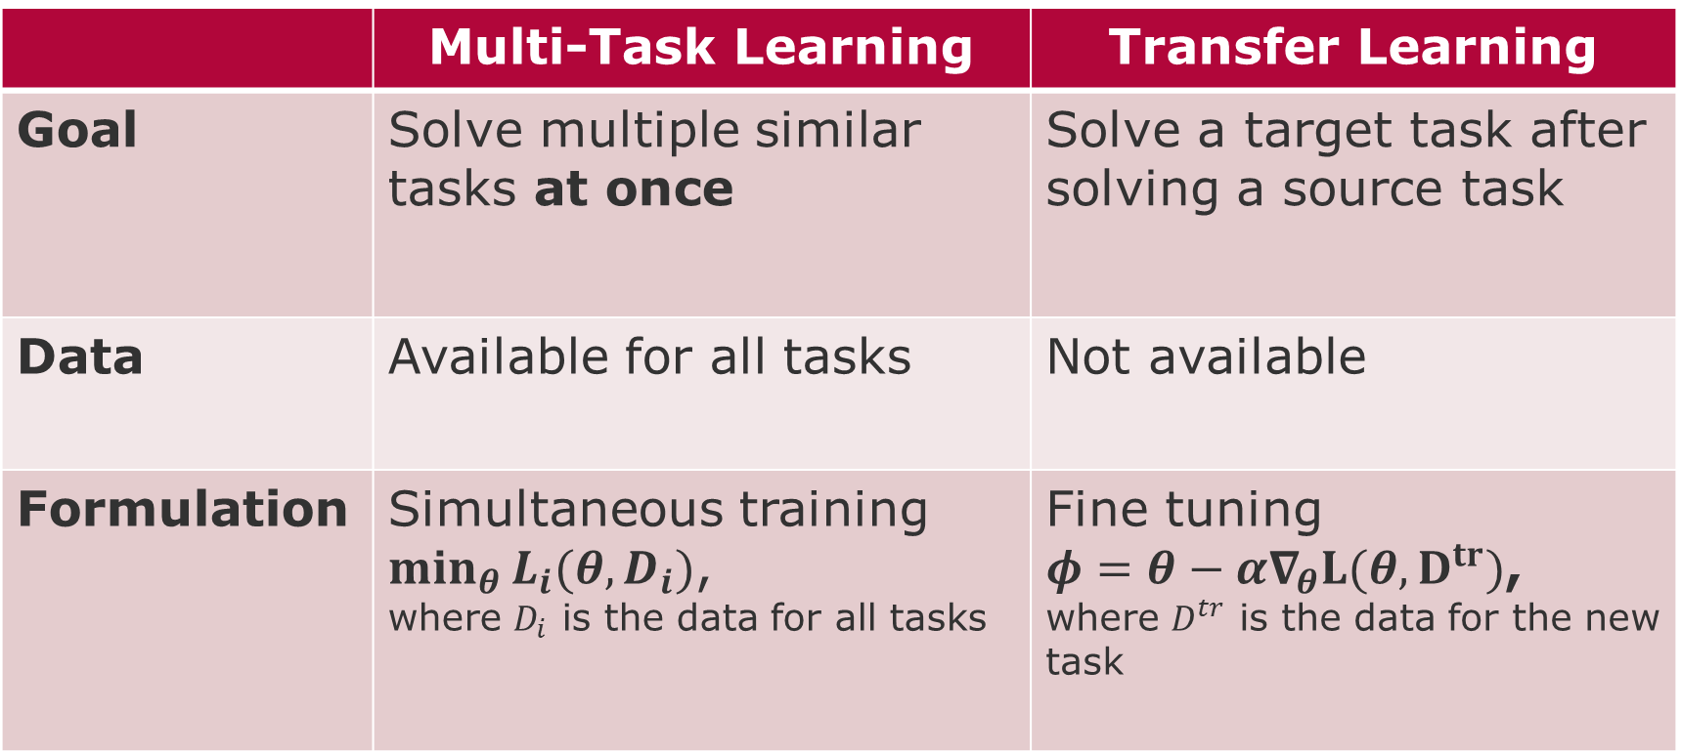
Multi-Task versus Transfer Learning
 | Multi-Task Learning | Transfer Learning
Goal | Solve multiple similar tasks at once | Solve a target task after solving a source task
Data | Available for all tasks | Not available
Formulation | Simultaneous training $\min_{θ}{L_{i}(θ,D_{i})}$, where $D_{i}$ is the data for all tasks | Fine tuning $φ=θ−α∇_{θ}L(θ,D^{tr})$, where $D^{tr}$ is the data for the new task
source: C. Finn, 2021, Lecture-3 CS 330 - https://cs330.stanford.edu/

Slide 6
Transfer Learning Challenges
Where do pre-trained parameters come from?
Benchmark datasets
Foundation models
Unsupervised learning techniques
How to Fine-Tune?
Fine-tune with smaller learning rate
Smaller learning rate for earlier layers
Freeze earlier layers and gradually unfreeze
Search hyperparameter space (via cross-validation)
Sensitive to architectural choices (e.g., ResNets)
source: C. Finn, 2021, Lecture-3 CS 330 - https://cs330.stanford.edu/

Slide 7
Why do we meta-learning?
Sparsity, Rare Events Transfer learning fine-tuning does not work
Unknown future tasks Multi-Task learning cannot work
Adversarial environment conditions:
Non-stationarity
Distribution Shifts
Concept Drifts
source: C. Finn, 2021, Lecture-3 CS 330 - https://cs330.stanford.edu/

Slide 8
Meta-Learning Perspectives
Mechanistic view
Deep network reads a whole dataset and make predictions on new points (inductive)
Training this network uses a “meta-dataset” for each task
Probabilistic view
Extract knowledge from a set of tasks that allows efficient learning of new tasks
Learning a new task uses this prior and (small) training set to infer most likely posterior distribution of the parameters
source: C. Finn, 2021, Lecture-3 CS 330 - https://cs330.stanford.edu/

Slide 9
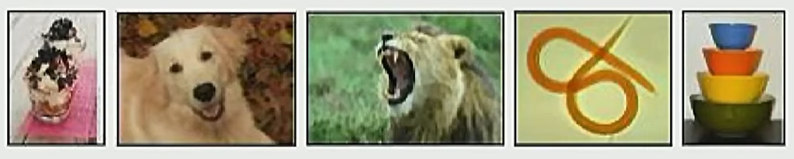
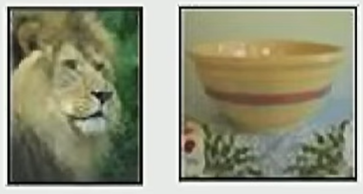
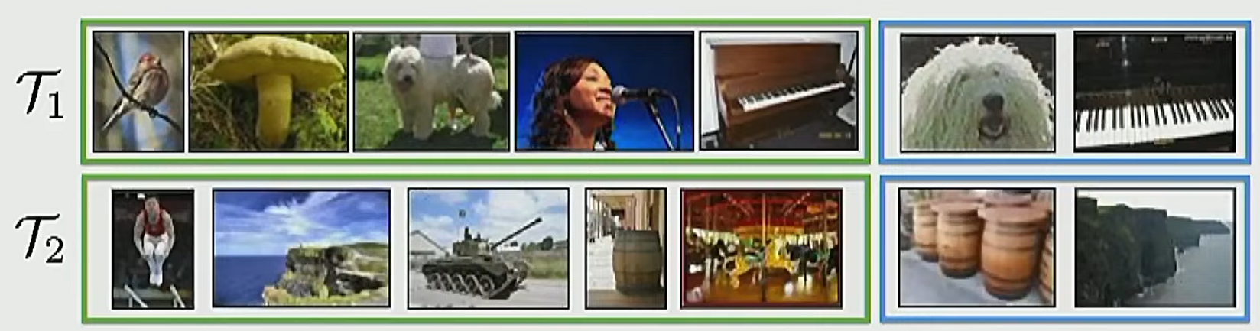
Meta-Learning how-to
Too few examples, cannot generalize for fine-tuning
Given 1 example of 5 classes
Categorize a new item
Meta-Testing
Approach: create a training setup that prepares the model to learn to categorize under sparsity
Meta-Training
Tasks:
Handwriting recognition from different languages
Feedback on different exams
Species in different regions of the globe
Robot performing different tasks
Data for these tasks are sampled i.i.d. from task distribution
source: C. Finn, 2021, Lecture-3 CS 330 - https://cs330.stanford.edu/

Slide 10
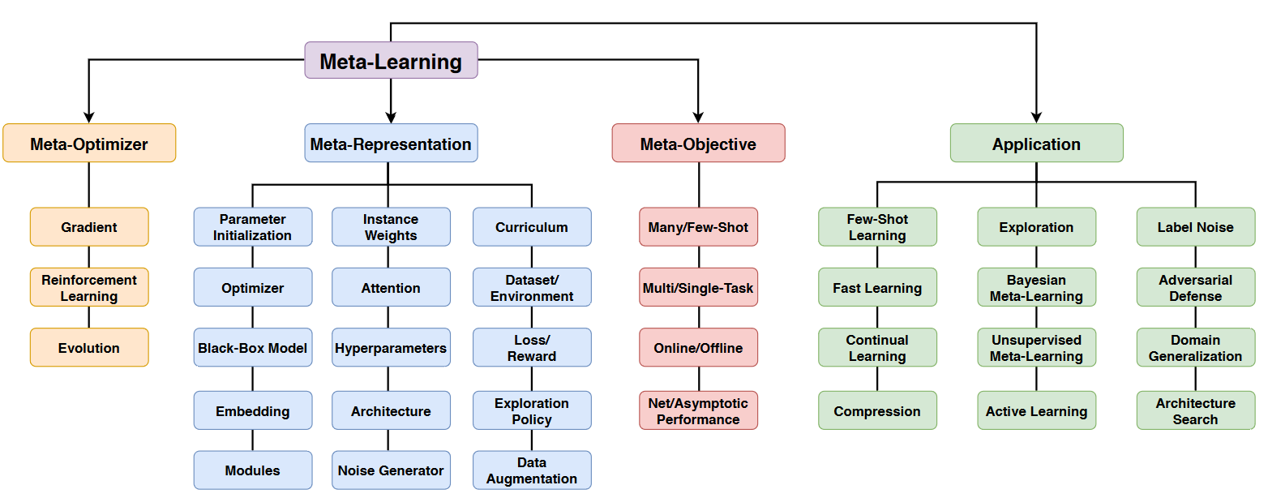
Meta-Learning Landscape [Hospedales et al. 2021]
Hospedales, Timothy, et al. "Meta-learning in neural networks: A survey." IEEE transactions on pattern analysis and machine intelligence 44.9 (2021): 5149-5169.

Slide 11





Meta-learning probabilistic view (task-distribution view)
Machine learning task
The conditioning on ω denotes the dependence of this solution on assumptions about ‘how to learn’, such as the choice of optimizer for θ or function class for f .
by solving:
Generalization is then measured by the number of test points with known labels.
Meta-learning probabilistic view (task-distribution view)
This Loss = performance of a model trained using ω on dataset D.
‘How to learn’, i.e., ω, is an across-task knowledge or meta-knowledge
Tasks sampled i.i.d. from a distribution
Meta-training
$D_{source}$contains train and validation sets
Meta-testing
Uses the meta-knowledge ω* to train the base model on each previously unseen target task(i)
Hospedales, Timothy, et al. "Meta-learning in neural networks: A survey." IEEE transactions on pattern analysis and machine intelligence 44.9 (2021): 5149-5169.

Slide 12

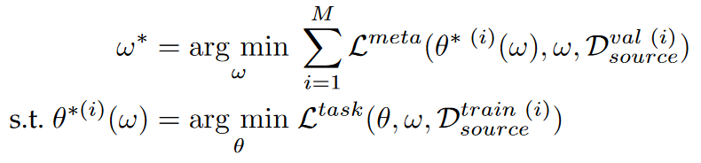


Meta-Learning: Bilevel Optimization View [1-3]
How to learn a strategy ω to produce models of
= Outer-objective
= Inner-objective, e.g., cross-entropy in classification tasks.
Three remarks:
The inner level optimization is conditional on the learning strategy ω
The learning strategy ω which is defined by the outer level,
The inner level cannot change ω during training
What is ω in concrete terms?
Initial conditions in a non-convex optimization, e.g., hyperparameters for regularization
Parameterization of the loss function to optimize
source: Hospedales, Timothy, et al. "Meta-learning in neural networks: A survey." IEEE transactions on pattern analysis and machine intelligence 44.9 (2021): 5149-5169.
[1] H. Stackelberg, The Theory Of Market Economy. Oxford University Press, 1952.
[2] L. Franceschi, P. Frasconi, S. Salzo, R. Grazzi, and M. Pontil, “Bilevel Programming For Hyperparameter Optimization And Meta-learning,” in ICML, 2018.
[3] A. Sinha, P. Malo, and K. Deb, “A Review On Bilevel Optimization: From Classical To Evolutionary Approaches And Applications,” IEEE Transactions on Evolutionary Computation, 2018.

Slide 13
Meta-Representation - Scope
Which aspects should be learned (part of the meta-knowledge ω) and which parts should be kept fixed?
Parameter Initialization: MAML [Finn et al., 2017, 2018, 2019] is most well-known example.
Assumption: a good initialization is just a few gradient steps away from a solution to any task T drawn from p(T ) and can help to learn without overfitting in few-shot learning.
Challenge: the outer optimization needs to solve for as many parameters as the inner optimization (potentially hundreds of millions in large CNNs).
Mitigation: isolate a subset of parameters to meta-learn, e.g., by subspace, by layer, by separating out scaling and shifting functions of DNN weights for each task
source: Hospedales, Timothy, et al. "Meta-learning in neural networks: A survey." IEEE transactions on pattern analysis and machine intelligence 44.9 (2021): 5149-5169.
C. Finn, P. Abbeel, and S. Levine, “Model-Agnostic Meta-learning For Fast Adaptation Of Deep Networks,” in ICML, 2017.
C. Finn, K. Xu, and S. Levine, “Probabilistic Model-agnostic Meta-learning,” in NeurIPS, 2018. C. Finn, A. Rajeswaran, S. Kakade, and S. Levine, “Online Meta-learning,” ICML, 2019.

Slide 14
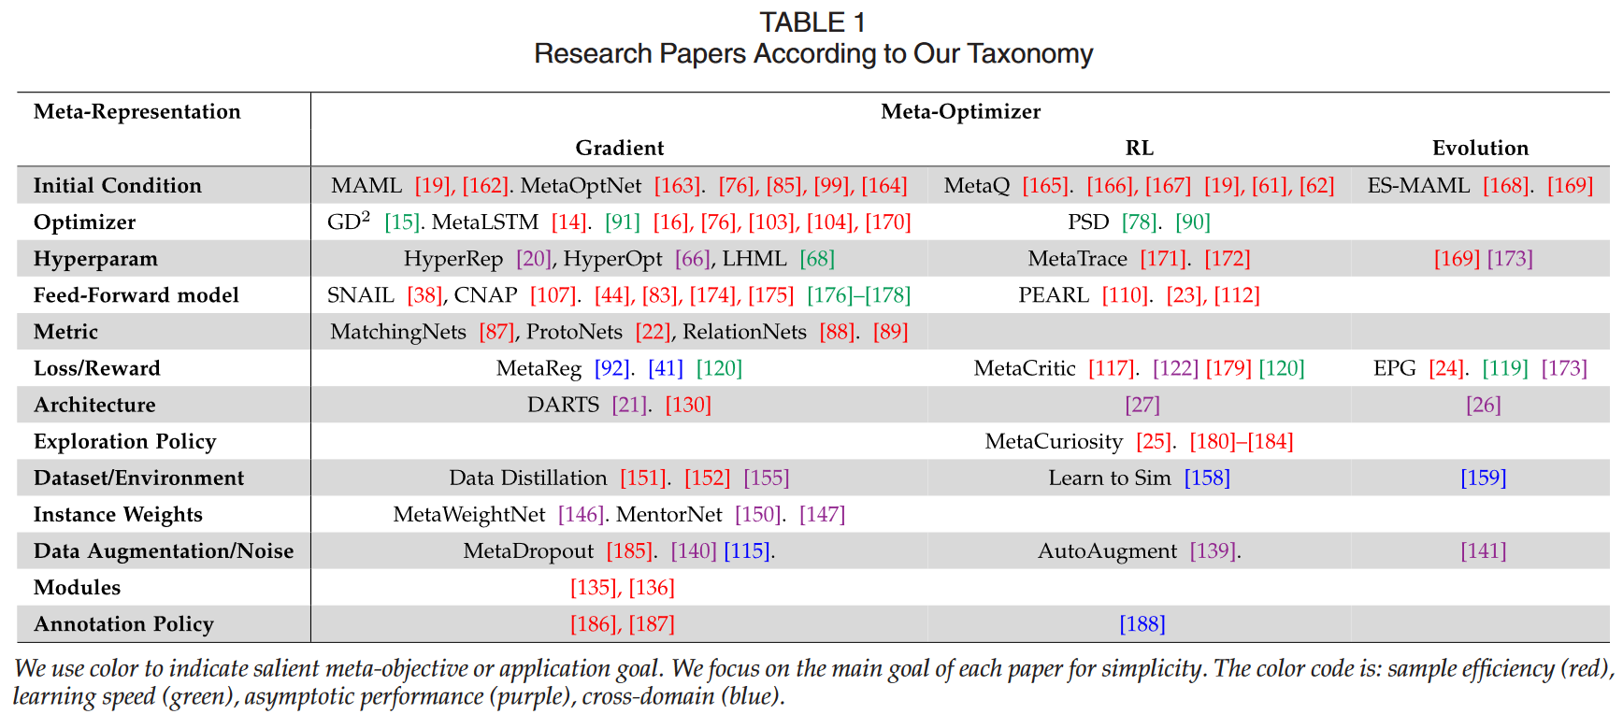
Meta-Representation - Papers
source: Hospedales, Timothy, et al. "Meta-learning in neural networks: A survey." IEEE transactions on pattern analysis and machine intelligence 44.9 (2021): 5149-5169.

Slide 15
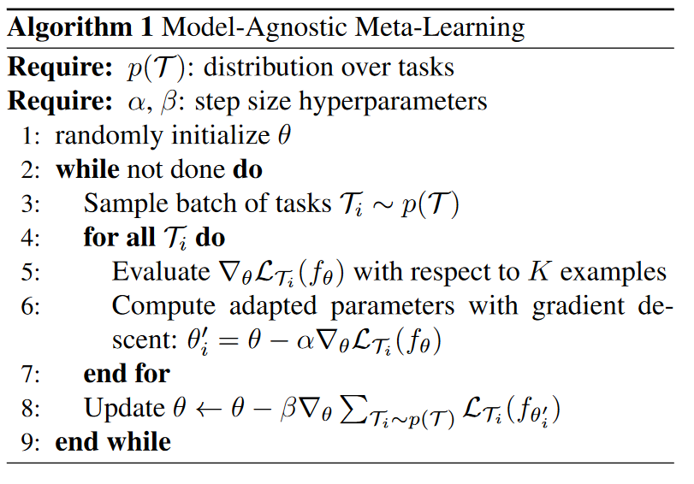
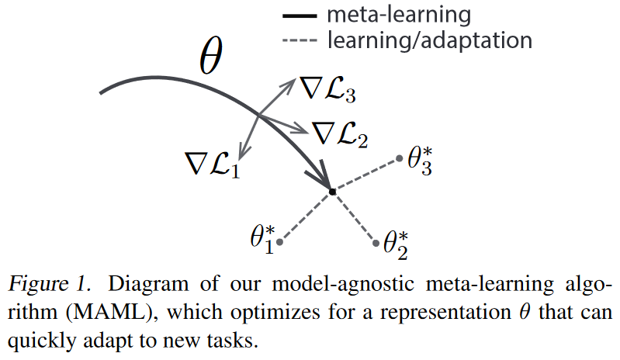
MAML [Finn et al. 2017]
C. Finn, P. Abbeel, and S. Levine, “Model-Agnostic Meta-learning For Fast Adaptation Of Deep Networks,” in ICML, 2017.

Slide 16
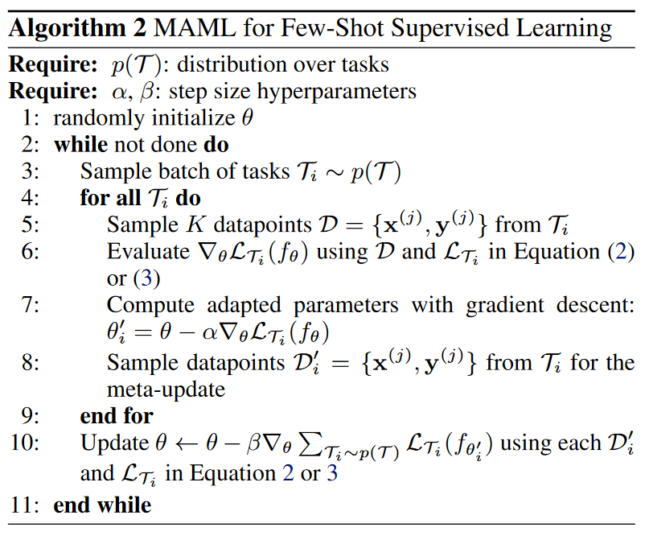
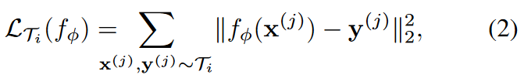
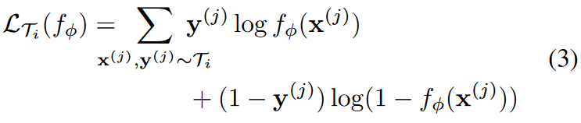
MAML [Finn et al. 2017] Few-Shot Supervised Learning
C. Finn, P. Abbeel, and S. Levine, “Model-Agnostic Meta-learning For Fast Adaptation Of Deep Networks,” in ICML, 2017.

Slide 17
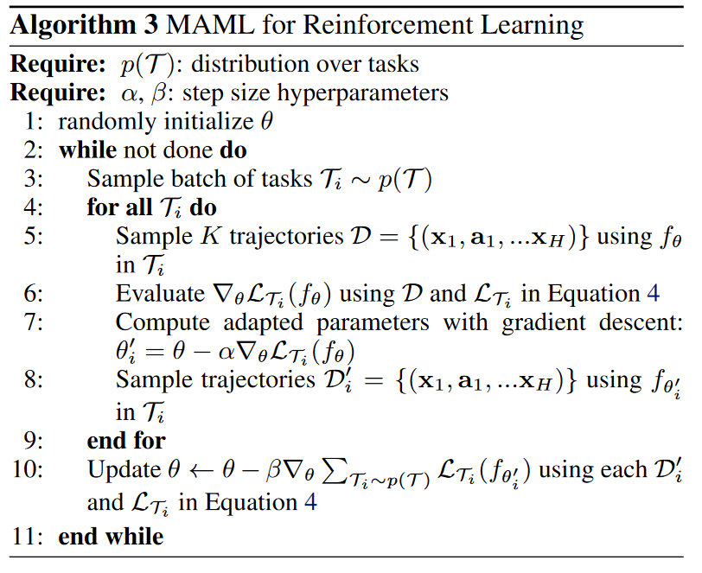
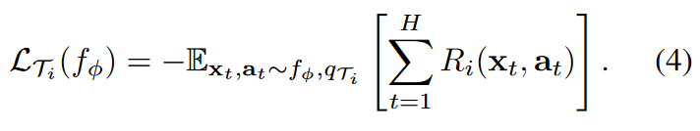
MAML [Finn et al. 2017] Reinforcement Learning
C. Finn, P. Abbeel, and S. Levine, “Model-Agnostic Meta-learning For Fast Adaptation Of Deep Networks,” in ICML, 2017.
Notes:
http://proceedings.mlr.press/v70/finn17a/finn17a.pdf

Slide 18
Recommended Readings
@juergen -> Finn, Chelsea, et al. "Online meta-learning." International Conference on Machine Learning. PMLR, 2019.
@Finn Kaiser -> Antoniou, Antreas, Harrison Edwards, and Amos Storkey. "How to train your MAML." arXiv preprint arXiv:1810.09502 (2018).
@Maximilian Goetz Raghu, Aniruddh, et al. "Rapid learning or feature reuse? towards understanding the effectiveness of maml." arXiv preprint arXiv:1909.09157 (2019).

Slide 19
End
Notes:
https://www.youtube.com/watch?v=ItPEBdD6VMk

Slide 20
Challenges
Meta-learning in neural networks: A survey.

